Slide 1
HEAT CONTROL INSTRUMENTS AND SERVICES

Slide 2
HEAT CONTROL INSTRUMENTS AND SERVICES.,
Specialized in :
Manufactures and suppliers of : Scientific, Laboratory and Industrial instruments,
Hospital Instruments cooling systems
Stainless Steel Fabrication, Mild Steel Fabrication, CNC Bending, CNC Laser Cutting, General Fabrication Etc.,

Slide 3
Emerged in the year 1994, Heat Control Instruments and Services is an ISO 9001-2015 certified Company it is a manufacturer, exporter and supplier of industry grade laboratory products. Being a quality centric business venture, we have been providing phenomenal products and services to its clients for a considerable period and now. The various products that we have been manufacturing and supplying are
Autoclave Vertical/ Horizontal Models, Bio Safety Cabinets, Bacteriological Incubator, BOD Incubator, Hot Air Oven, Muffle Furnace, Vacuum Oven, Water Bath Digital and thermostatic Models, Hotplate Digital and thermostatic Models, Humidity chamber, Heating and cooling Models, Laminar Airflow Vertical and Horizontal Models, Tray Drier, Soxhlet Extraction , Orbital Shaking Incubator, Heating Mantel, Oil Bath , Cooling chambers, Tissue culture rack,Stability chamber, Walk in chamber, Plant growth chamber, UV chamber, Blood cabinet, Shaking Water Bath Digital, Thawing Bath, Dry Bath,Ultra low freezers, Circulating Water Bath Cooling & Heating etc., we are committed to providing good class customer service and solutions
We are working with industries diverse as Educational Institutions, Research Industries, Food Industries, Hospitals, Pharmaceutical Companies, Water purification plants, Various government & nongovernment R & D Laboratories
We have attained a great deal of expertise over the period of years in developing these high-end products at industry leading prices. We have been exporting our products to many places . The methods that have been used by us to manufacture these technically superior products are one of the factors that have enabled us to cut down on the unwanted costs further lowering the cost of the product. We cater to a wide client-base in the industry who is satisfied with the constant high-level of performance that we have leveraged over the period of years. The quality of our services has been in the spotlight due to set quality guidelines that we follow while offering these products.
we have also specialized in General Fabrication of stainless steel, mild steel, Aluminum, Copper, Brass etc. Our highly skilled workforces have over 22 years’ experience in metal fabrication. With on-site facilities for TIG, MIG and Arc welding in both stainless steel, Mild steel & Aluminum, a CNC Fabrication shop with CNC Laser Cutting and CNC Press Brake, Hydraulic Shearing machine, Hydraulic Bending Machine and CNC Bending Machine. we can offer a comprehensive service to all our customers.
The business operations of Heat Control Instruments and Services are led by Mr. G NARAYANAN who is the solo proprietor of the company. The tremendous growth that we have witnessed in the past years has been mainly due to the futuristic policies laid down by Mr. G NARAYANAN. The innovative methods introduced by him to speed up the manufacturing and supply processes have played a vital role in taking the company to greater heights.
The infrastructure that we have built over a period of years has been designed to cater to the ever-growing demands of the industry. The fact that our infrastructural base is advanced has helped us to increase the production capacity to a great extent. One of our missions is to make sure that the overall quality of the products that we offer is not compromised. The advanced machines used in the manufacturing process have further helped us to achieve our goals.
We understand the various parameters revolving around the pre-agreed delivery timelines. Our team of experts is well-trained to deal with all kinds of complexities that may erupt while developing the range of products we deal in. Such challenges are dealt with not only during the manufacturing stage but also during the stage where these products are supplied. The professionalism that we disseminate through our services is widely appreciated by our clients and is duly recognized by various research organizations studying the trends in our industrial domain.

Slide 4
Sl. No. | Products Name | Sl. No. | Products Name
1 | ALL TYPE OF FABRICATION OF MILD STEEL AND STAINLESS STEEL
2 | HOT AIR OVEN | 21 | DEEP FREEZER VERTICAL
3 | B O D INCUBATOR | 22 | HUMIDITY CHAMBER HEATING/COOLING
4 | TRAY DRIER | 23 | ENIVRONMENTAL CHAMBER
5 | BACTERIOLOGICAL INCUBATOR | 24 | SEED GERMINATOR
6 | INDUSTRIAL BURNING /DRYING CHAMBER | 25 | BOOLD BANK REFRIGERATOR / BLOOD CABINET
7 | SERVOLOGICAL WATER BATH | 26 | DEEP FREEZER HORIZONTAL
8 | RING WATER BATH DIGITAL / THERMOSTATIC | 27 | ORBITAL SHAKING INCUBATOR
9 | COOLING WATER BATH | 28 | ROTARY SHAKER
10 | SHAKER WATER BATH DIGITAL | 29 | HOT PLATE DIGITAL / THERMOSTATIC
11 | CONSTANT WATER BATH | 30 | SOXHLET EXTRATION
12 | MUFFLE FURNANCE VERTICAL / RECTANGULAR | 31 | STABILITY CHAMBER
13 | OIL BATH | 32 | PLANT GROWTH CHAMBER
14 | VERTICAL AUTO CLAVE | 33 | UV CHAMBER
15 | HORIZONTAL AUTO CLAVE | 34 | THAWING BATH
16 | STABILITY CHAMBER | 35 | Bio Safety Cabinet
17 | VACUUM OVEN | 36 | DRY BATH
18 | COOLING CHAMBER | 37 | WALK-IN CHAMBER
19 | LAMINAR AIR FLOW VERTICAL/HORIZONTAL | 38 | CIRCULATING WATER BATH COOLING/HEATING
20 | HEATING MANTEL | 39 | TISSUE CULTURE RACKS

Slide 5
HEAT CONTROL INSTRUMENTS AND SERVICES.,
Clients get benefit of Dedicated support teams who seek to fully understand their products & requirements to optimise delivery of Fabricated materials that are flexible & cost effective, if you would like to visit to look around our factory or would like to speak to our team to discuss the project requirements
FACT / OFF : No.104, 3rd cross, 3rd phase, 6th main,
Peenya Industrial Area, Near State Bank of India,
Bangalore – 560058.
Phone : 080-41172224 / 08041172223
GST NO:29ABOPN6969Q1Z7
www.heatcontrol.info
Contact Details:
Mr . G NARAYANAN
Proprietor
Mobile - 9845028817
Gmail – heatcontrol24@gmail.com
- heatcontrolgn@gmail.com

Slide 6
CORE COMPETENCY
Customized Engineering Solutions using latest engineering tools – 2D (Auto CAD) And 3D (solid edge)
Machining & Fabrication
Assembly & Testing
Powder coating
Platino 2.0 Fiber”with 4 KW IPG source CNC Laser cutting machine
Shearing & Bending
CNC Shearing and Bending
General Fabrication
Lab Instruments on site servicing
Field services – Installation & Commissioning

Slide 7
SOME OF LAB INSTRUMENTS CLIENT DETAILS
Dealers are:
Alpha Enterprises
Anamatrix Instruments Technologies Private Limited
Bio Bee Tech
C. R. Instruments
Control Scientific Works
Culture Instruments
Heatron Industrial Heaters
Manasa Agencies
NRI Technologies
Raghavendra Scientific Works
Servewell Instruments Private Limited
Shree Krishna Scientific Equipment Suppliers
Srinivasa Products
Vijay Enterprises
Muhlenbau Equipments (P) Ltd
:
Some of the Pharma, Food Processing and Water Plant Companies are
Ace Bright (India) Pharma Pvt., Ltd.,
Altech Biotechnology Pvt Ltd
Bangalore Analytical Research Centre
Benir E-Store Solution Private Limited
Bill Forge Private Limited
Blue Neem Medical Devices Pvt., Ltd.,
Biocon Limited
Brindavan Roller Pvt., Ltd.,
Brilliant Bio Pharma Pvt., Ltd.,
Deutsch India Power Connectors
Gooly Consultancy Services
KDDL Hands division II
Likith Agro Foods Private Limited
Manan Health Care Pvt Ltd.
Ozone Scientific
RBI Technical Services
Raghavendra Spectro Metallurgical Laboratory
Shakthi Krian Foods Pvt., Ltd.,
Sree Krishna Beverages
Sunil Agro Foods Limited-Unit II

Slide 8
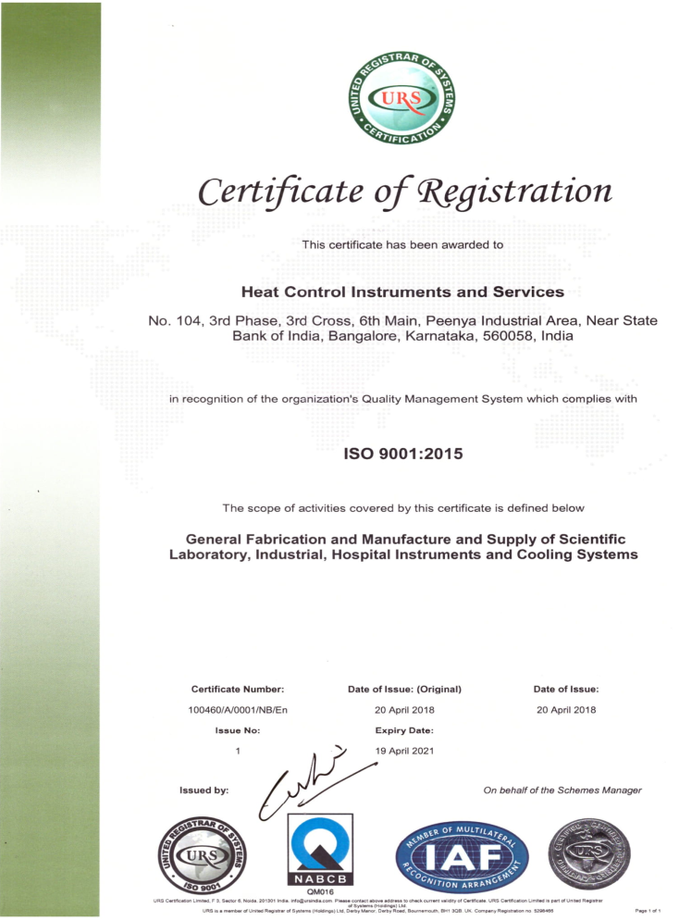
ISO 9001 - 2015

Slide 9
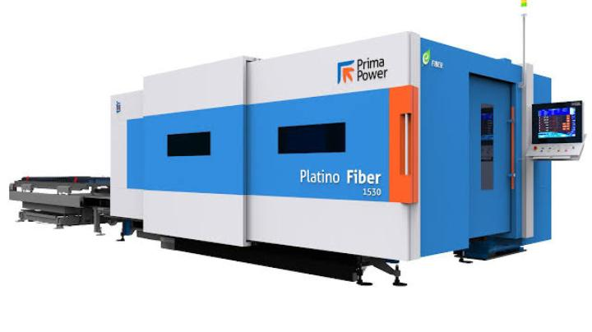
Model-“Platino 2.0 Fiber”with 4 KW IPG source

Slide 10
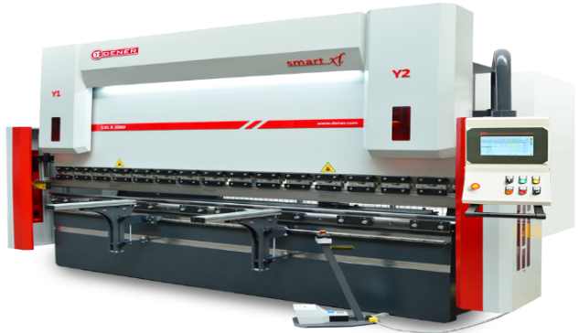
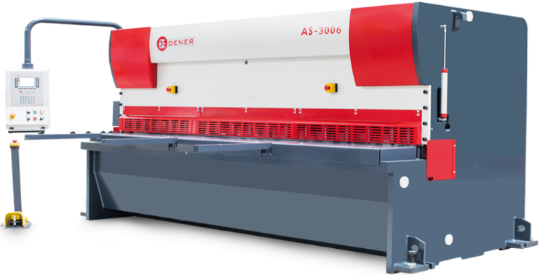
DENER CNC GUILLOTINE SHEARING MACHINE MODEL:DM-HVM1
DENER CNC SERVO HYBRID PRESS BRAKE MODEL:DD-H22030

Slide 11
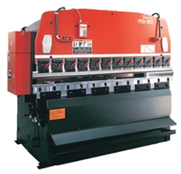
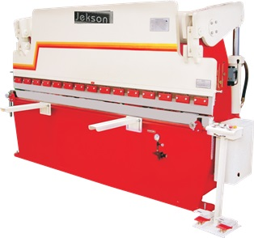

Slide 12
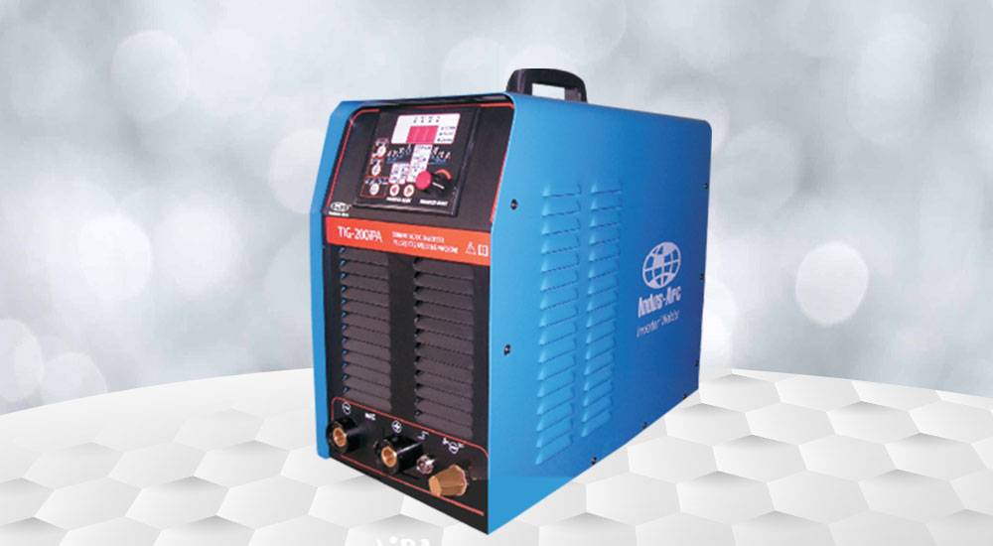
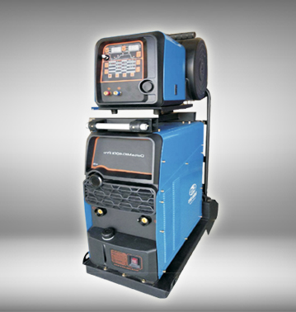
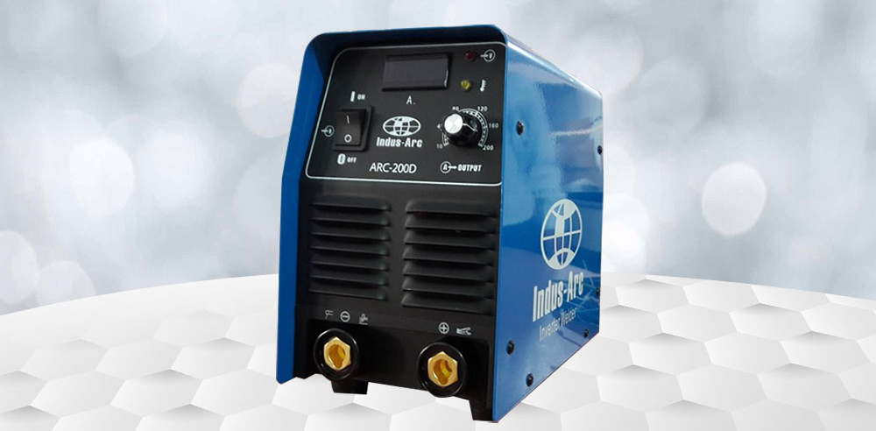

Slide 13
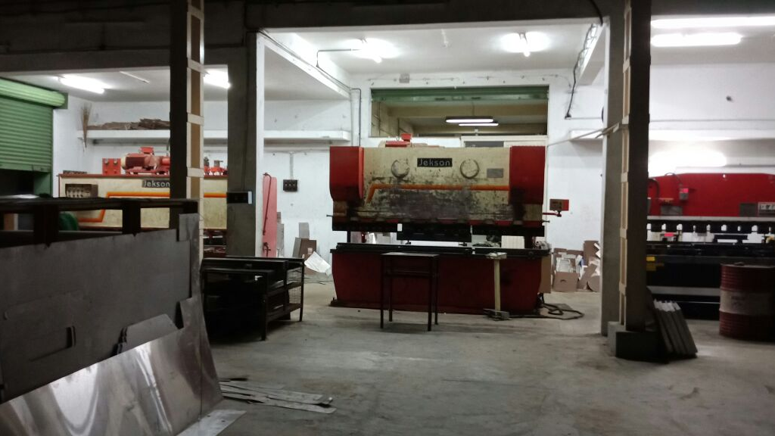
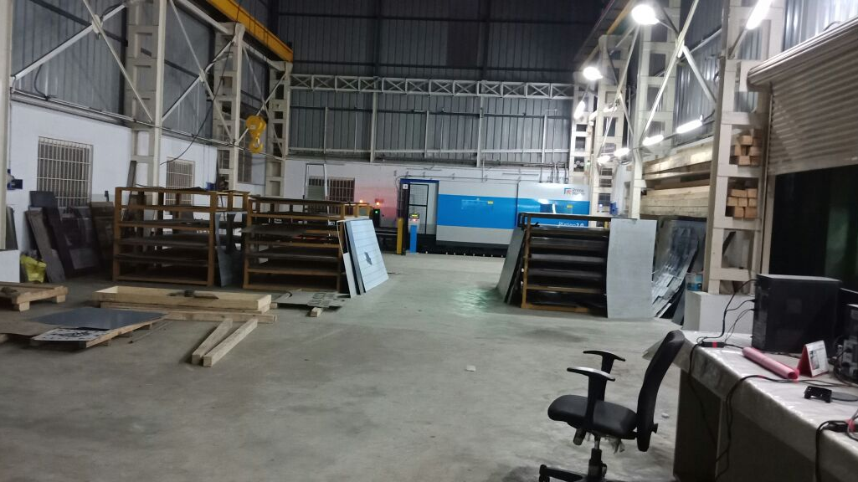
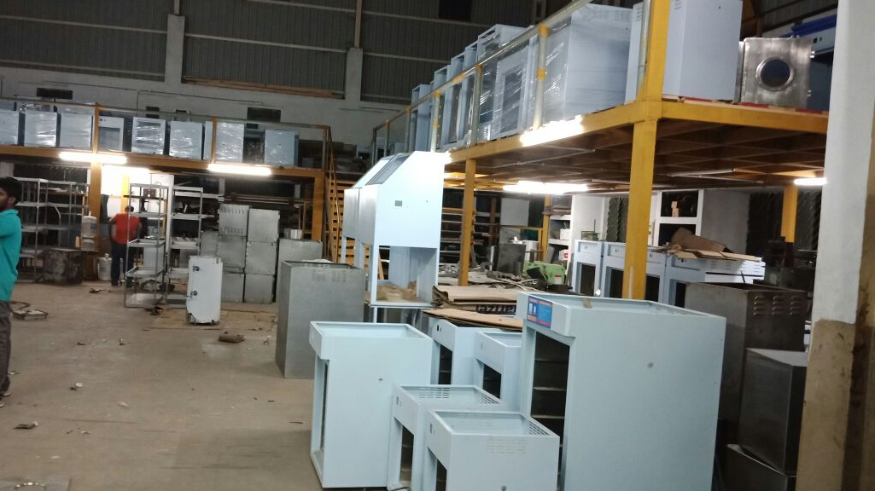
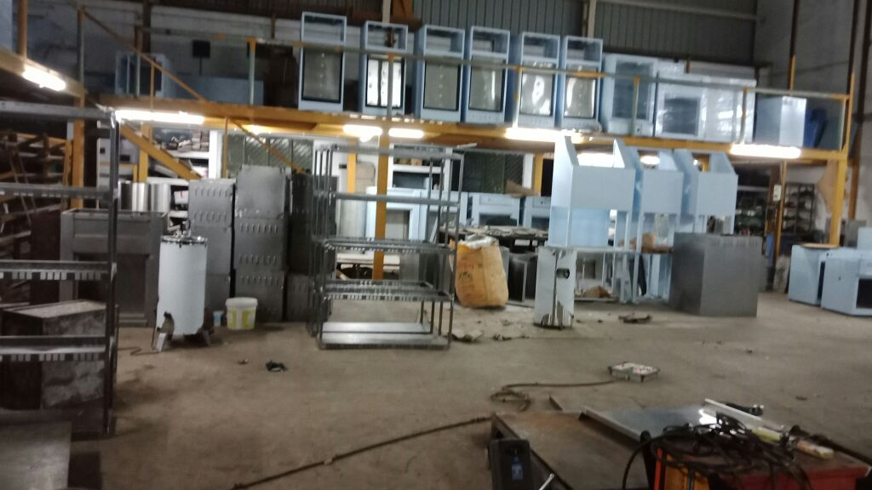

Slide 14
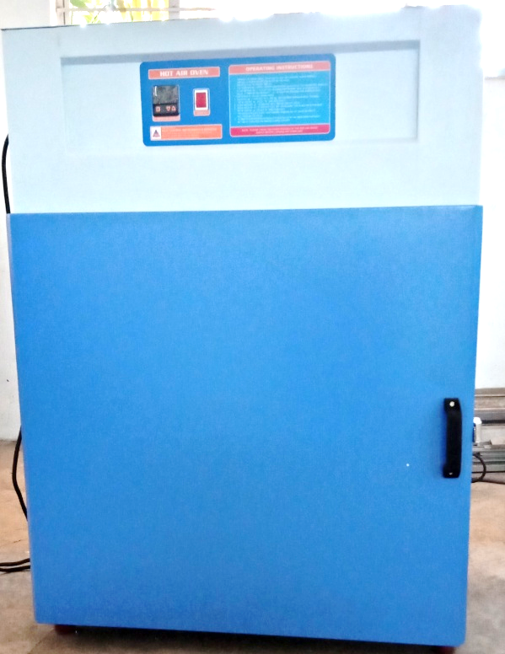
TECHNICAL SPECIFICATION
Chamber Design | Double walled
Inner Chamber | Inner chamber made of stainless steel 304 Grade OR stainless steel 316 Grade
Outer Chamber | Outer chamber made of mild steel finished with powder coated OR stainless steel 304 Grade
Insulationa | Insulation between inner and outer chamber is filled with high grade glass wool with a gap of 75mm thickness, to withstand maximum Temperature 200° C [Depending upon Temperature].
Air Circulation Fan Motor | The motorized forced air circulation is provided at the back to maintain uniform temperature inside the chamber
Heaters | Air Heaters are made of high grade Kanthal wires of suitable wattage.
Gasket | An asbestos rope or Neoprene/ Silicon rubber (optional) gasket is provided for the door to avoid air leakage and temperature loss from Instrument.
Trays | Perforated removable stainless-steel trays at the fixed distance.
Temperature Range | 5 °C above ambient to 200°C.
Temperature Controller | Microprocessor based PID temperature controller with dual display (Process value and set value), low and high limit setting with Cr Al thermocouple and Timer control (optional).
Temperature Resolution | 0.1°C
Temperature Accuracy | ± 1°C.
Temperature Accuracy | ± 2°C.
Temperature Uniformity | ± 3°C.
Power Supply | 230 Volts Single Phase 50Hz, AC supply.
HOT AIR OVEN
Standard Size
SL. NO | Liters Cap | Model No | Inner chamber size [ WXDXH] cm | Outer chamber size [ WXDXH] cm | Power in [watts] | No. of Trays
1 | 5 | HAO-7 | 17.5 x 17.5x17.5 | 38.5 x 60 x 57.5 | 750 | 1
2 | 42 | HAO-14 | 35X 35 X 35 | 56 x 76 x 75 | 1200 | 2
3 | 90 | HAO-18 | 45X 45 X 45 | 66 x 86 x 84 | 1500 | 3
4 | 120 | HAO-18/24 | 45X 45 X 60 | 66 x 86 x 100 | 1750 | 3
5 | 210 | HAO-24 | 60X 60 X 60 | 81 x 101 x 100 | 2000 | 3
6 | 320 | HAO-24/36 | 60X 60 X 90 | 81x102.5x130 | 3000 | 3

Slide 15
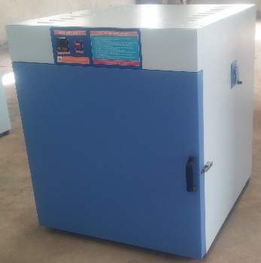
HOT AIR OVEN DUCTED AIRFLOW TYPE
TECHNICAL SPECIFICATION
Chamber Design | Triple Walled, ducted air type Three chamber body.
Inner Chamber | Inner and Inner most chamber made of stainless steel 304 Grade OR stainless steel 316 Grade
Outer Chamber | Outer chamber made of mild steel finished with powder coated OR stainless steel 304 Grade
Insulation | Insulation between inner and outer chamber is filled with high grade glass wool with a gap of 75mm thickness, to withstand maximum Temperature 200° C. [Depending upon Temperature].
Air Circulation Fan Motor | The motorized forced air circulation is provided at the Top to maintain uniform temperature inside the chamber
Heaters | Air Heaters are made of high grade Kanthal wires of suitable wattage.
Gasket | An asbestos rope or Neoprene/ Silicon rubber (optional) gasket is provided for the door to avoid air leakage and temperature loss from Instrument.
Trays | Three perforated removable stainless-steel trays at the fixed distance.
Temperature Range | 5 °C above ambient to 200°C.
Temperature Controller | Microprocessor based PID temperature controller with dual display (Process value and set value), low and high limit setting with Cr Al thermocouple and Timer control (optional).
Temperature Resolution | 0.1°C
Temperature Accuracy | ± 1°C.
Temperature Uniformity | ± 3°C.
Power Supply | 230 Volts Single Phase 50Hz, AC supply.
Power Supply | 440 Volts Three Phase 50Hz, AC supply.
Standard Size
SL. NO | Liters Cap | Model No | Inner chamber size [ WXDXH] cm | Outer chamber size [ WXDXH] cm | Power in[watts]
1 | 90 | HAO-D-18 | 45x 45 x 45 | 77 x 70 x 95 | 1500
2 | 120 | HAO-D-18/24 | 45X 45 X 60 | 77 x 70 x 110 | 1750
3 | 210 | HAO-D-24 | 60x 60 x 60 | 92 x 85 x 110 | 2000
4 | 320 | HAO-D-24/36 | 60x 60 x 90 | 92 x 85 x 140 | 3000
5 | 430 | HAO-D-24/48 | 60x 60 x 120 | 92 x 85 x 170 | 3500
6 | 500 | HAO-D-30/36 | 75x 75 x 90 | 107 x 100 x 140 | 4000
7 | 650 | HAO-D-36/24/48 | 90 x 60x 120 | 122 x 85 x 170 | 4500
8 | 730 | HAO-D-36/ | 90x 90 x 90 | 122 x 115 x 140 | 5000
9 | 970 | HAO-D-36/48 | 90x 90 x 120 | 122 x 115 x 170 | 6000

Slide 16
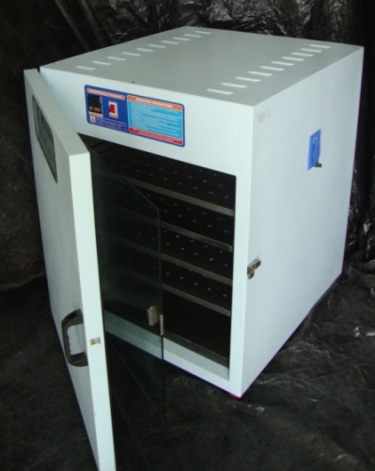
BACTERIOLOGICAL INCUBATOR
TECHNICAL SPECIFICATION
Chamber Design | Double walled
Inner Chamber | Inner chamber made of stainless steel 304 Grade OR stainless steel 316 Grade
Outer Chamber | Outer chamber made of mild steel and finished with powder coated. OR stainless steel 304 Grade
Insulation | Insulation between inner and outer chamber is filled with high grade glass wool with a gap of 65mm thickness, to withstand maximum Temperature 60° C
Air Circulation Fan Motor | The motorized forced air circulation is provided at the back to maintain uniform temperature inside the chamber
Heaters | Tubular air heater are made of high grade Kanthal wires of suitable wattage.
Inner Glass Door | Inner full- length glass door is provided to view the samples without disturbing the temperature
Gasket | Rubber gasket and latch is provided for the door is provided for the door to avoid air leakage and temperature loss from Instrument.
Trays | Three perforated removable stainless-steel trays at the fixed distance.
Temperature Range | 5 °C above ambient to 65°C
Temperature Controller | Microprocessor based PID temperature controller with dual display (Process value and set value), low and high limit setting with PT100 sensor and Timer control (optional).
Temperature Resolution | 0.1°C
Temperature Accuracy | ± 1°C.
Temperature Uniformity | ± 3°C.
Power Supply | 230 Volts Single Phase 50Hz, AC supply.
Standard Size
SL. NO | Liters.Cap | Model No | Inner chamber size [ WXDXH] cm | Power in[watts]
1. | 42 | BI-14 | 35X 35 X 35 | 400
2 | 90 | BI-18 | 45X 45 X 45 | 500
3 | 120 | BI-18/24 | 45X 45 X 60 | 600
4 | 210 | BI-24 | 60X 60 X 60 | 750
5 | 320 | BI-24/36 | 60X 60 X 90 | 1000

Slide 17
BACTERIOLOGICAL INCUBATOR DUCTED AIRFLOW TYPE
TECHNICAL SPECIFICATION
Chamber Design | Triple Walled, ducted air type Three chamber body
Inner most Chamber | Inner and Inner most chamber made of stainless steel 304 Grade OR stainless steel 316 Grade
Outer Chamber | Outer chamber made of mild steel and finished with powder coated. OR stainless steel 304 Grade
Insulation | Insulation between inner and outer chamber is filled with high grade glass wool with a gap of 65mm thickness, to withstand maximum Temperature 60° C
Air Circulation Fan Motor | The motorized forced air circulation is provided at the Top to maintain uniform temperature inside the chamber
Heaters | Tubular air heater are made of high grade Kanthal wires of suitable wattage.
Inner Glass Door | Inner full- length glass door is provided to view the samples without disturbing the temperature
Gasket | Rubber gasket and latch is provided for the door is provided for the door to avoid air leakage and temperature loss from Instrument.
Trays | Three perforated removable stainless-steel trays at the fixed distance.
Temperature Range | 5 °C above ambient to 65°C
Temperature Controller | Microprocessor based PID temperature controller with dual display (Process value and set value), low and high limit setting with PT100 sensor and Timer control (optional).
Temperature Resolution | 0.1°C
Temperature Accuracy | ± 1°C.
Temperature Uniformity | ± 3°C.
Standard Size
SL. NO | Liters. Cap | Model No | Inner chamber size [ WXDXH] cm | Power in[watts]
1 | 90 | BI-D-18 | 45x 45 x 45 | 400
2 | 120 | BI-D-18/24 | 45X 45 X 60 | 500
3 | 210 | BI-D-24 | 60x 60 x 60 | 600
4 | 320 | BI-D-24/36 | 60x 60 x 90 | 750
5 | 430 | BI-D-24/48 | 60x 60 x 120 | 1000
6 | 500 | BI-D-30/36 | 75x 75 x 90 | 1000
7 | 650 | BI-D-36/24/48 | 90 x 60x 120 | 1750
8 | 730 | BI-D-36 | 90x 90 x 90 | 2000
9 | 970 | BI-D-36/48 | 90x 90 x 120 | 2500

Slide 18
B O D INCUBATOR
TECHNICAL SPECIFICATION
Chamber Design | Double walled
Inner Chamber | Inner chamber made of stainless steel 304 Grade OR stainless steel 316 Grade
Outer Chamber | Outer chamber made of mild steel and finished with powder coated. OR stainless steel 304 Grade
Insulation | Insulation between inner and outer chamber is filled with high grade glass wool with a gap of 65mm thickness, to withstand maximum Temperature 60° C
Wheels | The unit is mounted on a sturdy steel frame with cast iron wheels for easy movements. ( For higher capacity only).
Conditioning system Air Circulation Fan Motor | The triple walled back of the instrument is provided with air circulation fans. The chamber is equipped with a vertical recalculating conditioning stream of air sucking from the top of the inner chamber and allows passing through the back side of the inner chamber duct and carrying heating/cooling/humidity which enters from the bottom of the chamber this process continuous to maintain uniformity throughout the chamber.
Cooling | An energy efficient cooling unit is installed in our instrument hermetically sealed compressors. These compressors are the heavy-duty industrial type noise free; vibration free and air-cooled Compressors start in sequence to protect the unit from overloading. We use CFC free environmentally friendly refrigerant and compressors of Kirloskar/Tecumseh make, conforming to latest international standards and guidelines
Inner Glass Door | Inner full- length glass door is provided to view the samples without disturbing the temperature
Outer Door | Inner stainless steel and Outer made of Mild steel finished with powder coated OR stainless steel 304 Grade
Gasket | Rubber gasket and latch is provided for the door is provided for the door to avoid air leakage and temperature loss from Instrument.
Trays | Two/Three perforated removable stainless-steel trays at the fixed distance.
Temperature Range | 10°C to 60°C
Temperature Controller | Microprocessor based PID temperature controller with dual display (Process value and set value), low and high limit setting with PT-100 Sensor and Timer control (optional).
Temperature Resolution | 0.1°C
Temperature Accuracy | ± 2°C.
Temperature Uniformity | ± 3°C.
Power Supply | 230 Volts Single Phase 50Hz, AC supply.
Inner Viewing Light | Door Switch with viewing light will be provided to view the samples inside the Chamber [optional] at an extra cost.
Chamber Illumination | Cyclic Timer with Floursent tube / LD light will be provided on either side of the inner Chamber [optional] at an extra cost.
Standard Size
SL. NO | Liters. Cap cubic/ feet | Model | Inner chamber size [ WXDXH] cm | Outer chamber size [ WXDXH] cm | Power in [watts]
1 | 90/3 | BOD-3 | 43x 42x 50 | 54x84x90 | 750
2 | 112/4 | BOD-4 | 50x 45x 50 | 63x94x98 | 1000
3 | 165/6 | BOD-6 | 50x 45x 75 | 64x90x150 | 1500
4 | 285/10 | BOD-10 | 58X55X90 | 73x102x166 | 2000
5 | 340/12 | BOD-12 | 60x 55x 105 | 74x103x183 | 3000

Slide 19
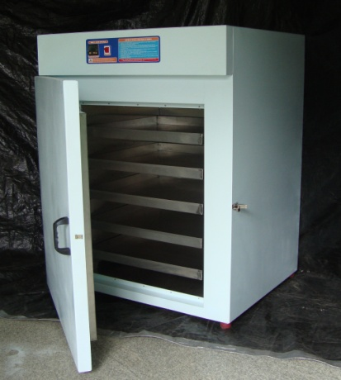
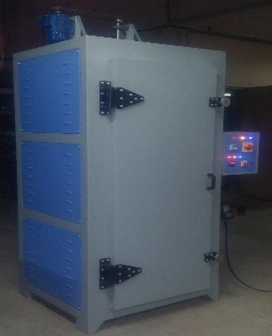
TRAY DRIER
TECHNICAL SPECIFICATION
Chamber Design | Triple Walled, ducted air type Three chamber body.
Inner and Inner Most Chamber | Inner and Inner most chamber made of stainless steel 304 Grade
Outer Chamber | Outer chamber made of mild steel finished with powder coated.
Insulation | Insulation between inner and outer chamber is filled with high grade glass wool with a gap of 75mm thickness, to withstand maximum Temperature 200° C
Air Circulation Fan Motor | The motorized forced air circulation is provided at the Side to maintain uniform temperature inside the chamber and opposite side air Vent provided to disperse the moisture.
Heaters | Air Heaters are made of high grade Kanthal wires of suitable wattage.
Gasket | Neoprene/ Silicon (Optional) rubber gasket is provided for the door to avoid air leakage and temperature loss from Instrument.
Trays | The unit is provided with Sheet or mesh stainless steel grades-304. of size 81 x 40 x 3 [WXDXH] cm trays.
Temperature Range | 5 °C above ambient to 200°C.
Temperature Controller | Microprocessor based PID temperature controller with dual display (Process value and set value), low and high limit setting with Cr Al thermocouple and Timer control (optional).
Temperature Resolution | 0.1°C
Temperature Accuracy | ± 1°C.
Temperature Accuracy | ± 2°C.
Temperature Uniformity | ± 3°C.
Temperature Uniformity | ± 5°C.
Power Supply | 230 Volts Single Phase 50Hz, AC supply.
Power Supply | 440 Volts Three Phase 50Hz, AC supply.
Standard Size
SL No | Liters. Cap. No of trays | Model No | Inner chamber size [ WXDXH] cm | Outer chamber size [ WXDXH] cm | Power in [watts]
1 | 368/12 | TD12 | 84 X 43 X102 |  | 2500
2 | 728/24 | TD24 | 85 x 84 x 102 |  | 4000
3 | 1072/36 | TD36 | 85 x 84 x 150 |  | 6000
4 | 1414/48 | TD48 | 85 x 84 x 198 |  | 7500

Slide 20
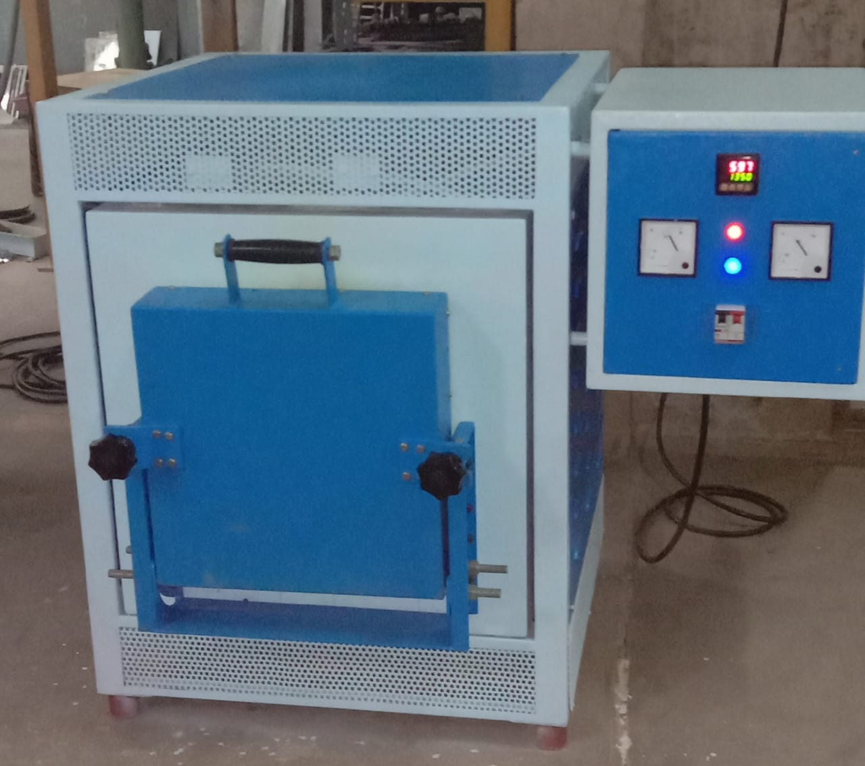
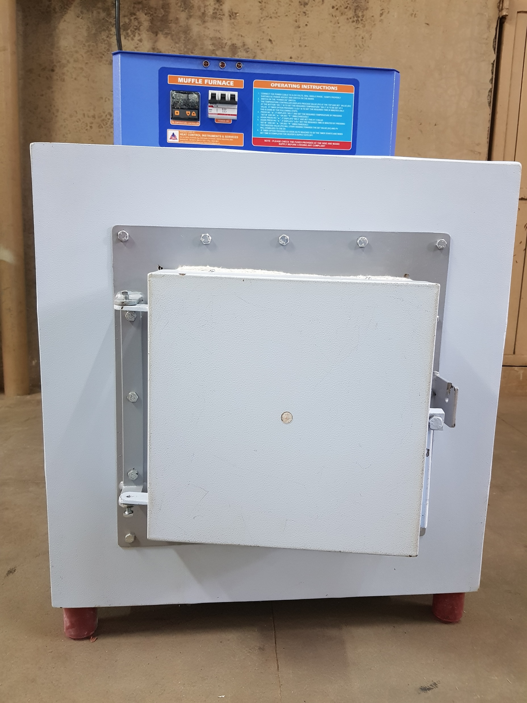
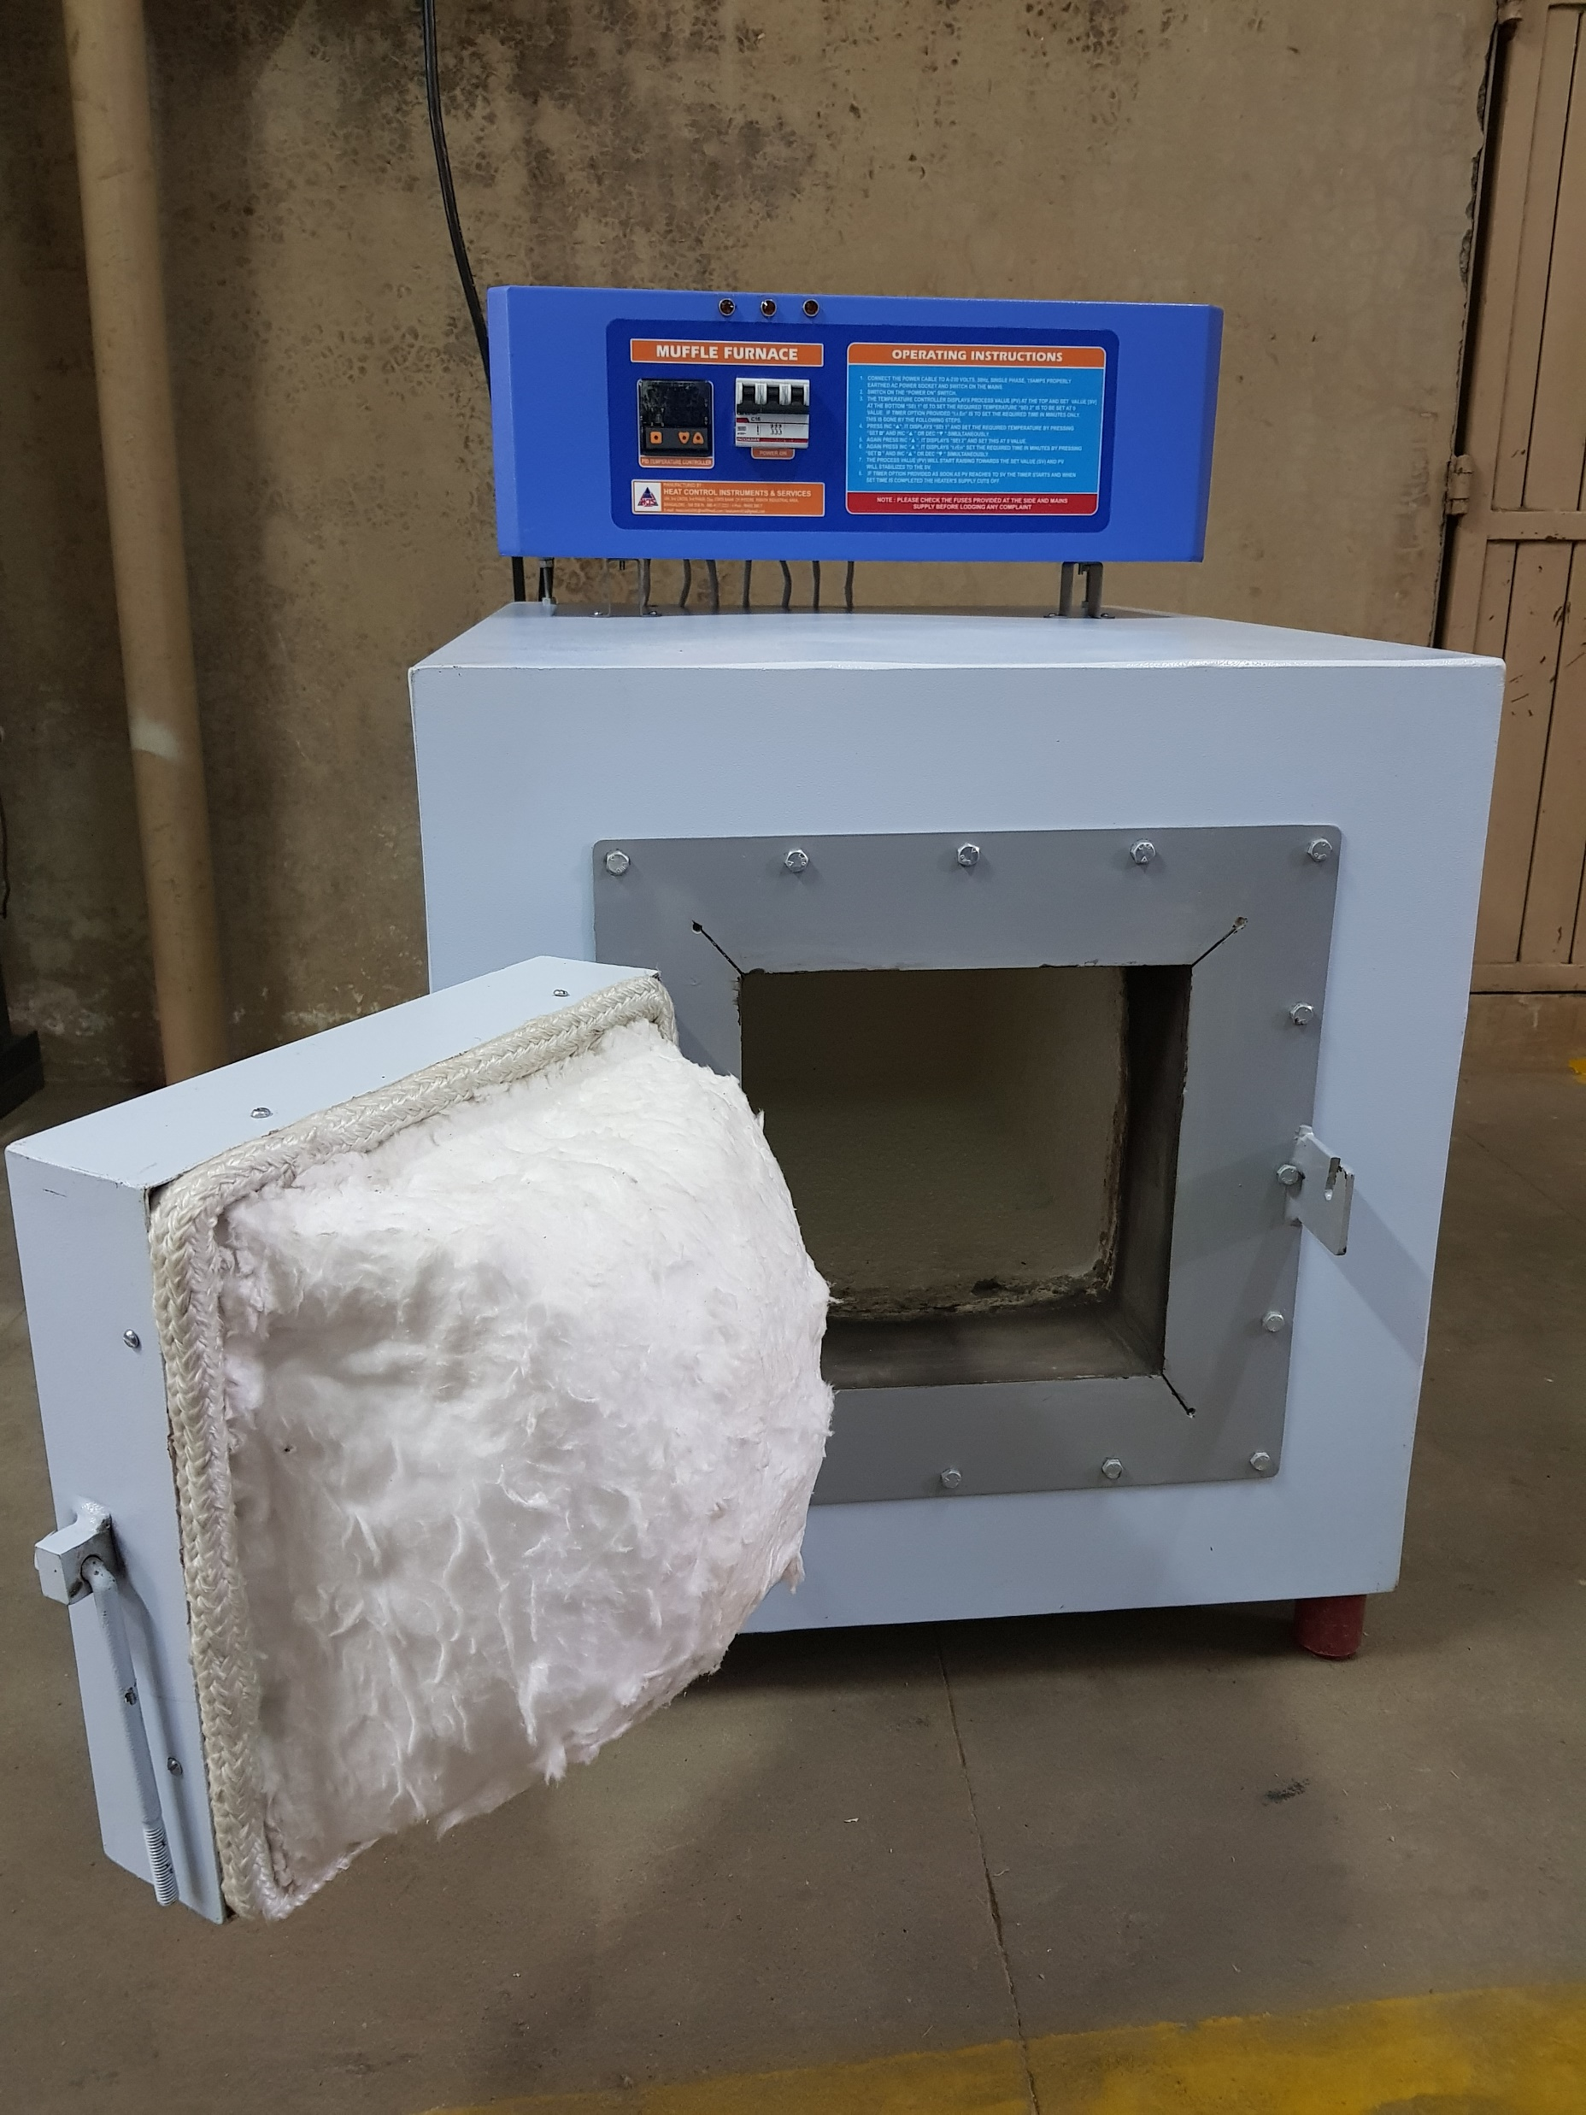
Muffle Furnace
TECHNICAL SPECIFICATION
Chamber Design | Double walled
Inner Chamber | Inner muffle wound on Kanthal A1 heating elements and embedded with high quality ceramic cement to avoid heat loss
Outer Chamber | Outer chamber made of mild steel and finished with powder coated.
Insulation | In between muffle and outer walls insulated with high quality light weight ceramic fibre.
Heaters | High grade Kanthal wires wounded on a muffle of suitable wattage.
Gasket | An asbestos rope gasket is provided for the door to avoid air leakage and temperature loss from Instrument.
Temperature Range | 5 °C above ambient to 1000°C.
Temperature Controller | Microprocessor based PID temperature controller with dual display (Process value and set value), low and high limit setting with Thermocouple CRAL ‘K’ type timer control.
Thyrister Controller | For replacement of temperature controller to get better accuracy of temperature from minimum to maximum specified temperature range given and to avoid over soot at lower temperature is done by thyristericed temperature controller with Thyisterized Pack. At on extra cost of Rs.9,800.00 up to 5 Kw Single Phase Above 5 to 10 kw the cost around 20,000.00
Temperature Resolution | 0.1°C
Temperature Accuracy | ± 3°C.
Temperature Uniformity | ± 5°C.
Power Supply | 230 Volts Single Phase 50Hz, AC supply.
Power Supply | 440 Volts Three Phase 50Hz, AC supply. For above 5 KW.
Standard Size
Sl.No. | Model No | Inner chamber size [WXDXH] cm | Outer chamber size [ WXDXH] cm | Power in Kilo Watts
1 | MF-494-1000 | 100x225x100 | 420x520x650 | 2
2 | MF-5105-1000 | 125x250x125 |  | 2.5
3 | MF-6126-1000 | 150x300x150 | 460x650x720 | 3
4 | MF-8128-1000 | 200x300x200 | 500x650x760 | 4.5
5 | MF-9189-1000 | 225x450x225 | 530x800x800 | 7.5 to 9

Slide 21
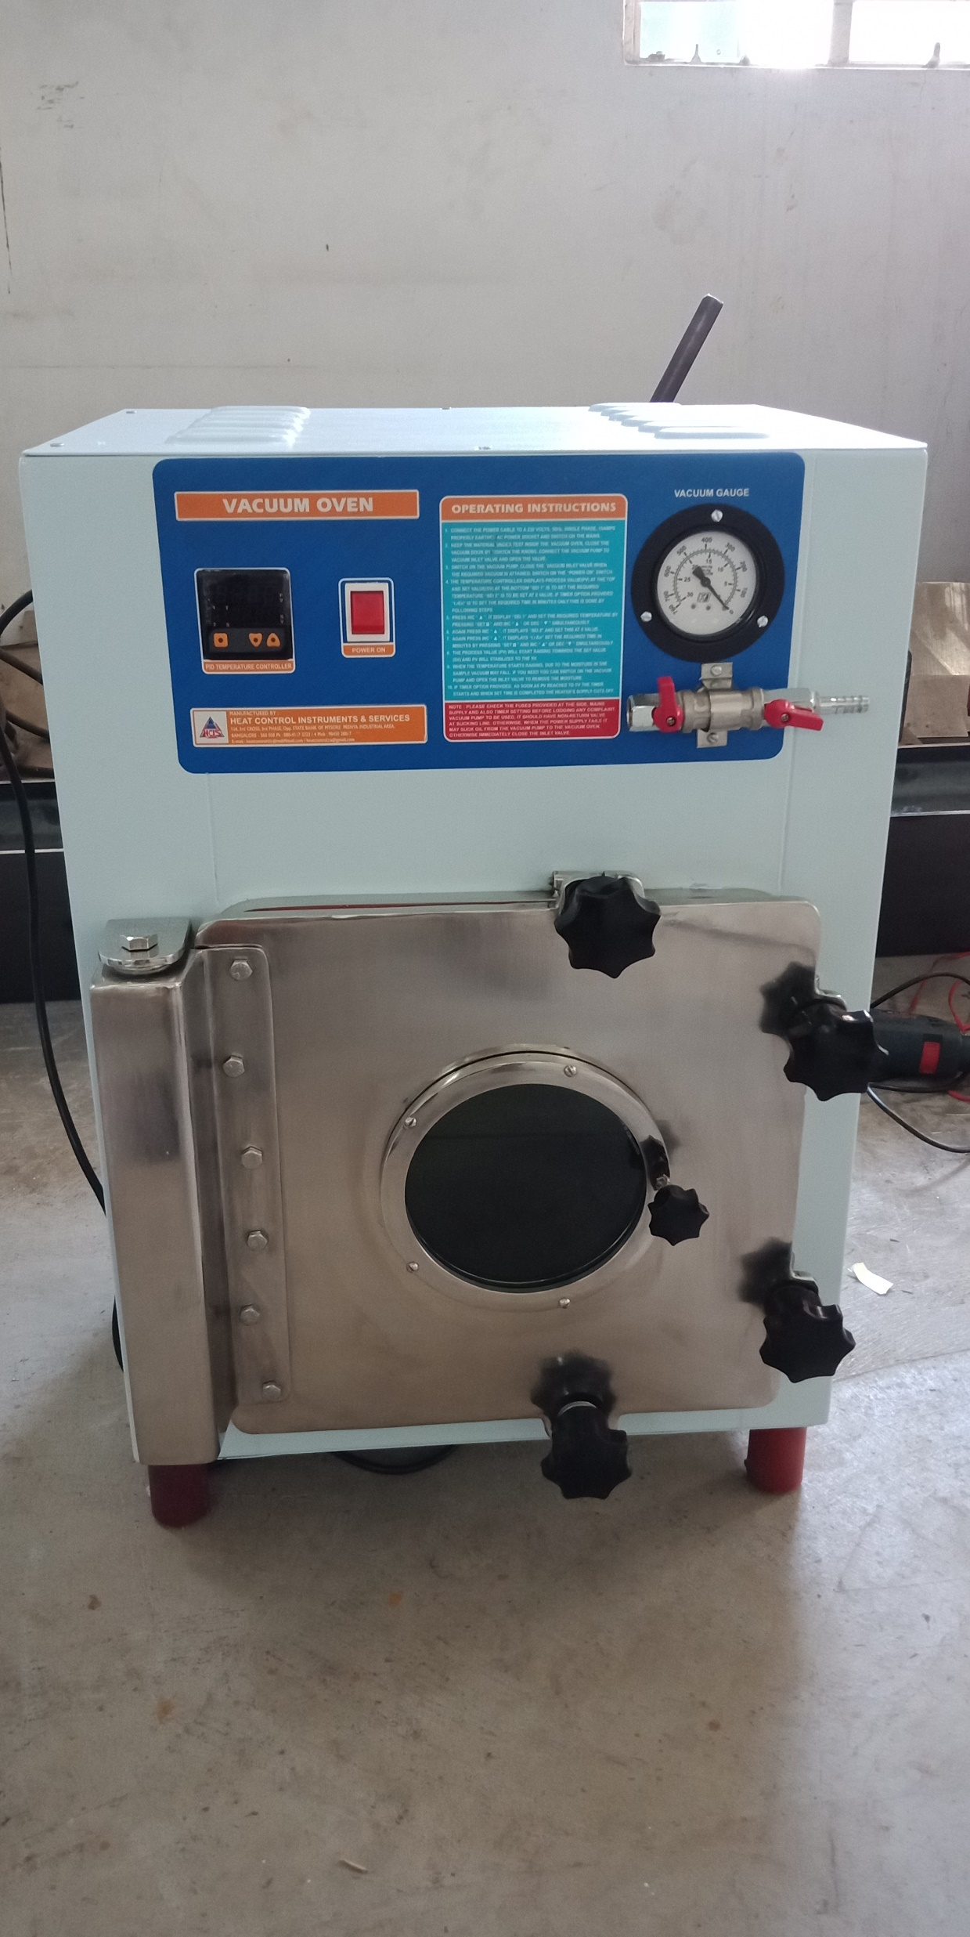
VACUUM OVEN
(RECTAGULAR)
TECHNICAL SPECIFICATION
Chamber Design | Double walled
Inner Chamber | Inner chamber made of stainless steel 304 Grade
Outer Chamber | Outer chamber made of mild steel and finished with powder coated.
Insulation | Insulation between inner and outer chamber is filled with high grade glass wool with a gap of 65mm thickness
Heaters | Memmert type Air Heaters are made of high grade Kanthal wires of suitable wattage, wound on the all around the Chamber.
Gasket | Silicon rubber gaskets with effective door locking system for 100% sealing to hold vacuum effectively
Door Glass Window | The door has viewing tough glass window with leak proof sealed. Door , Hinges, lock Hinges made of SS- 304 grade
Accessories Fitted | It has vacuum gauge, vacuum release valve and vacuum inlet valve
Trays | Two perforated removable stainless steel trays at the fixed distance.
Vacuum attainable | Vacuum attainable up to 670mm/Hg.
Temperature Range | 5 °C above ambient to 200°C.
Temperature Controller | Microprocessor based PID controller with dual display (Process value and set value), low and high limit setting and Cr Al thermocouple.
Temperature Resolution | 0.1°C
Temperature Accuracy | ± 2°C.
Temperature Uniformity | ± 8°C.
Power Supply | 230 Volts Single Phase 50Hz, AC supply.
Standard Size
Sl. No. | Liters. Cap | Rectangular Model No | Inner chamber size [ WXDXH] Inches | Outer chamber size [ WXDXH] cm | Power in[watts]
1 | 28 | VO121212 | 12”x12”x12” | 680x480x740 | 500
2 | 35 | VO121215 | 12”x12”x15” |  | 600
3 | 44 | VO121515 | 12” x 15”x15” | 490x530x 690 | 700
4 | 64 | VO141420 | 14”x 14”x20” |  | 800
5 | 78 | VO151818 | 15” x18” x18” | 565 600x 760 | 900
6 | 91 | VO181818 | 18” x18” x18” | 650 x 600x760 | 1000
7 | 189 | VO202424 | 20”x24”x24” | 685x750x 910 | 1300
8 | 226 | VO242424 | 24”x24”x24” | 785 x750x 910 | 1500

Slide 22
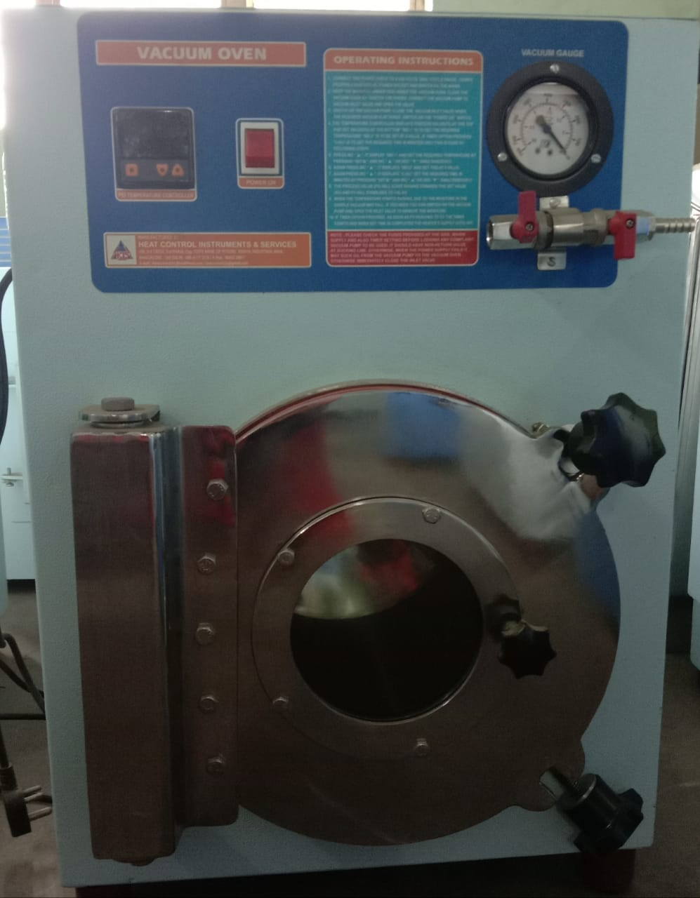
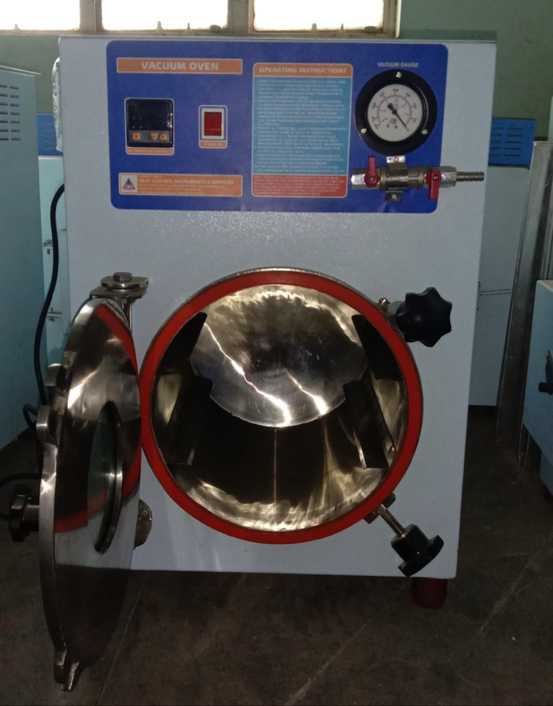
VACUUM OVEN
(CYLINDRICAL)
TECHNICAL SPECIFICATION
Chamber Design | Double walled
Inner Chamber | Inner chamber made of stainless steel 304 Grade
Outer Chamber | Outer chamber made of mild steel and finished with powder coated.
Insulation | Insulation between inner and outer chamber is filled with high grade glass wool with a gap of 65mm thickness
Heaters | Memmert type Air Heaters are made of high grade Kanthal wires of suitable wattage, wound on the all around the Chamber.
Gasket | Silicon rubber gaskets with effective door locking system for 100% sealing to hold vacuum effectively
Door Glass Window | The door has viewing tough glass window with leak proof sealed. Door , Hinges, lock Hinges made of SS- 304 grade
Accessories Fitted | It has vacuum gauge, vacuum release valve and vacuum inlet valve
Trays | Two perforated removable stainless steel trays at the fixed distance.
Vacuum attainable | Vacuum attainable up to 670mm/Hg.
Temperature Range | 5 °C above ambient to 200°C.
Temperature Controller | Microprocessor based PID controller with dual display (Process value and set value), low and high limit setting and Cr Al thermocouple.
Temperature Resolution | 0.1°C
Temperature Accuracy | ± 2°C.
Temperature Uniformity | ± 8°C.
Power Supply | 230 Volts Single Phase 50Hz, AC supply.
Standard Size
SL. NO | Liters. Cap | Cylindrical -Model No | Inner chamber size [ WXDXH] Inches | Outer chamber size WXDXH] cm | Power in[watts
1 | 18 | VO9d12 | 9”dia x 12”D | 570x440x660 | 400
2 | 22 | VO12d12 | 12”diax12” D | 660x490x740 | 475
3 | 27 | VO12d15 | 12”diax15”D | 490x530x 645 | 500
4 | 33 | VO12d18 | 12”diax 18”D |  | 600
5 | 51 | VO15d18 | 15”diax18”D |  | 700
6 | 74 | VO18d18 | 18”diax18”D | 565x 600x 690 | 800
7 | 123 | VO20d24 | 20”diax 24”D | 685x750x 810 | 1100

Slide 23
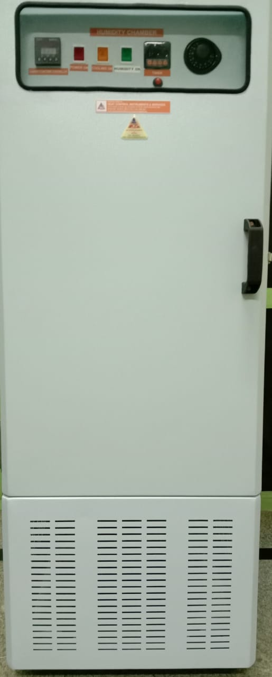
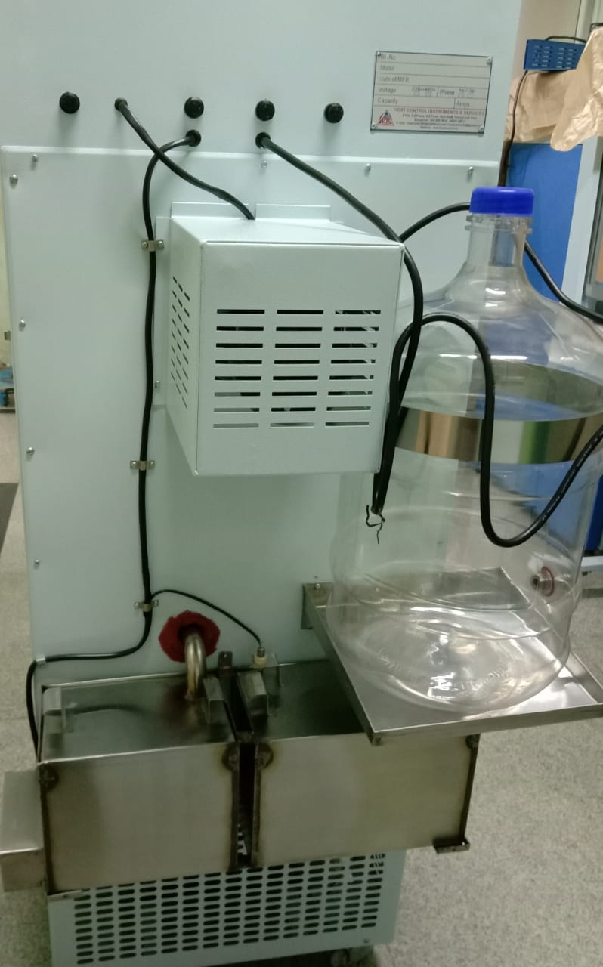
HUMIDITY CHAMBER/ STABILITY CHAMBER
TECHNICAL SPECIFICATION
Chamber Design | Double walled
Inner Chamber | Inner chamber made of stainless steel 304 Grade
Outer Chamber | Outer chamber made of mild steel and finished with powder coated.
Door | The door is provided with rubber gasket door closer. The outer door is made of mild steel sheet and finished with powder coated. The Inner door is made of stainless steel sheet of grade 304. The door is provided with latch type lock and Bakelite/PVC handle.
Inner Glass Door | Inner full- length glass door is provided to view the samples without disturbing the temperature
Wheels | The unit is mounted on a sturdy steel frame with cast iron wheels for easy movements. ( For higher capacity only).
Conditioning system | The triple walled back of the instrument is provided with air circulation fans. The chamber is equipped with a vertical recalculating conditioning stream of air sucking from the top of the inner chamber and allows passing through the back side of the inner chamber duct and carrying heating/cooling/humidity which enters from the bottom of the chamber this process continuous to maintain uniformity throughout the chamber.
Trays | The unit is provided with 3 Nos. Mesh type removable Stainless Steel Rod trays at a Fixed Distance.
Heating | Indirect heating system is provided in our units, and air heater which is made of high grade Kanthal heating wires of suitable wattage and is fixed at back side of the inner duct near the circulation fan. The warm air is evenly distributed throughout the chamber through efficient motor fans ensuring very good temperature sensitivity.
Cooling | An energy efficient cooling unit is installed in our instrument hermetically sealed compressors. These compressors are the heavy duty industrial type noise free, vibration free and air cooled Compressors start in sequence to protect the unit from overloading. We use CFC free environmentally friendly refrigerant and compressors of Kirloskar/Tecumseh make, conforming to latest international standards and guidelines
Humidity | Humidity generation is incorporated in our Instruments by means of aerosol humidity generator or by steam boiler provided at the back of the outer chamber which produces the steam enters inside the inner chamber to maintain required humidity. Lower humidity ranges are attainable with an optional auxiliary dryer system (ONLY OPTIONAL.)
Temperature Controlled | Microprocessor based PID Temperature controller with PT-100 Sensor.
Humidity Controlled | Microprocessor based RH controller cum indicator with direct reading RH sensor.
Temperature Range | Temperature range o10°C to 60°C.
Humidity Range | From Ambient to 95% (As per the humidity Requirements)
Standard Size
SL. NO | Liters. Cap | Model No | Inner chamber size [ WXDXH] cm | Outer chamber size [ WXDXH] cm | Power in[watts]
 | cubic/ feet |  |  | 21+X-41+X-40+X
1 | 165/6 | HC-6-C | 50x 45x 75 | 64x90x150 | 1500
2 | 285/10 | HC-10-C | 58X55X90 | 73x102x166 | 2000
3 | 340/12 | HC-12-C | 60x 55x 105 | 74x103x183 | 3000

Slide 24
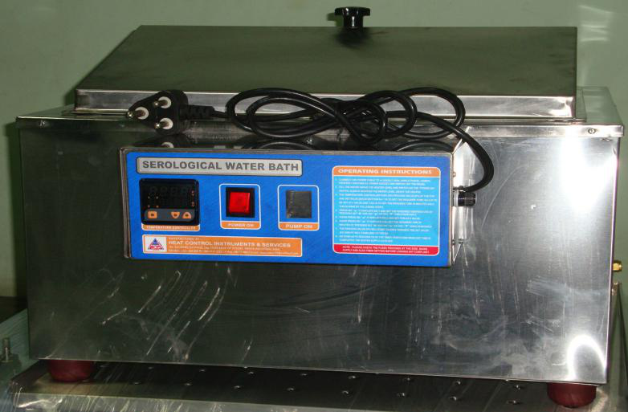
SEROLOGICAL WATER BATH
TECHNICAL SPECIFICATION
Chamber Design | Double walled
Inner Chamber | Inner chamber made of stainless steel 304 Grade OR stainless steel 304 Grade
Outer Chamber | Outer chamber made of stainless steel 304 Grade
Drain Valve | chamber drain nozzle at bottom with Dome type Lid
Circulating Pump | Inner Stirrer and External Circulating Stainless steel Pump fitted at top. At an extra cost (Optional) for better accuracy and Uniformity.
Top Lid | Dome type lid.
Insulation | Insulation between inner and outer chamber is filled with high grade glass wool with a gap of 65mm thickness, to withstand maximum Temperature 95° C
Heaters | Immersed Heaters are made of high grade Kanthal wires of suitable wattage.
Temperature Controller | Thermostatic control OR Microprocessor based PID temperature controller with dual display (Process value and set value), low and high limit setting with PT 100 Sensor Timer control (optional).
Welding | Inner Bath Completely Argon welded
Temperature Range | 5 °C above ambient to 95°C.
Temperature Resolution | 5°C
Temperature Accuracy | ± 5°C.
Temperature Uniformity | ± 10°C.
Power Supply | 230 Volts Single Phase 50Hz, AC supply.
Standard Size
SL. NO | Liters. Cap | Model No | Inner chamber size [ L x W x D] cm excluding heater | Power in[watts]
1 | 6 | SWB2 | 20x 20 x 15 | 1000
2 | 13 | SWB4 | 25X 35X 15 | 2000
3 | 24 | SWB8 | 40X 30X 17.5 | 2000
4 | 35 | SWB10 | 50 x 35 x 17.5 | 3000

Slide 25
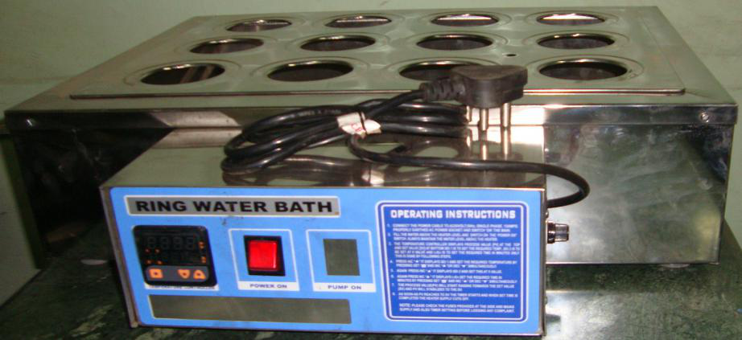
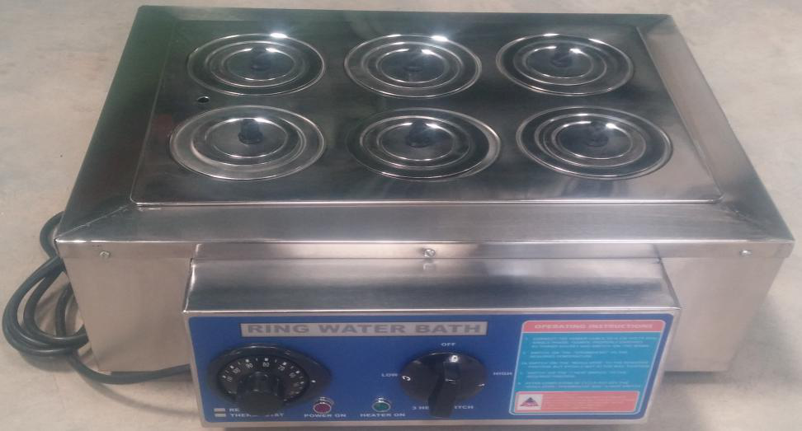
RING WATER BATH
TECHNICAL SPECIFICATION
Chamber Design | Double walled
Inner Chamber | Inner chamber made of stainless steel 304 Grade OR stainless steel 316 Grade
Outer Chamber | Outer chamber made of stainless steel 304 Grade
Drain Valve | chamber drain nozzle at bottom with concentric rings of 7.5cm diameter holes
Top Lid | Concentric rings of 7.5cm diameter holes
Insulation | Insulation between inner and outer chamber is filled with high grade glass wool with a gap of 65mm thickness, to withstand maximum Temperature 95° C
Heaters | Immersed Heaters are made of high grade Kanthal wires of suitable wattage.
Temperature Range | 5 °C above ambient to 95°C.
Temperature Controller | Thermostatic control OR Microprocessor based PID temperature controller with dual display (Process value and set value), low and high limit setting with PT 100 Sensor Timer control (optional).
Welding | Inner Bath Completely Argon welded
Temperature Resolution | 5°C
Temperature Accuracy | ± 5°C.
Temperature Uniformity | ± 10°C.
Power Supply | 230 Volts Single Phase 50Hz, AC supply.
Standard Size
Sl. No. | No of Holes | Model No | Inner chamber size | Power in[watts]
1 | 6 | RWB6 | 35X 25X 10 | 2000
2 | 12 | RWB12 | 48X 35X 10 | 2000

Slide 26
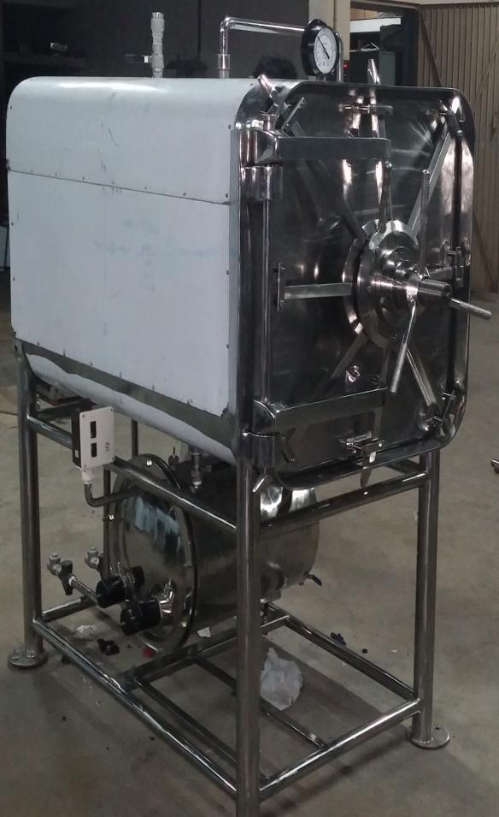
HORIZANTAL
AUTOCLAVE
RECTANGULAR
TECHNICAL SPECIFICATION
Chamber Design | Cylindrical Triple Walled, Three chamber body Jacketed model.
Inner and Jacket Chamber | Inner, and Jacket chamber made of stainless steel 304 Grade
Outer Chamber | Door Plate and outer chamber made of stainless steel 304 Grade
Insulation | Insulation between Jacket and outer chamber is filled with high grade glass wool with a gap of 50mm thickness, to withstand maximum Temperature 150° C
Heaters | Flanged Type Immersion Heaters are made of high grade Kanthal wires of suitable wattage
Gasket | Neoprene rubber gasket is provided for the door to avoid steam leakage and air tight pressure proof gasket.
Gasket | Silicon rubber gasket is provided for the door to avoid steam leakage and air tight pressure proof gasket. (Optional)
Door Tightened for Circular model | The door tightened by Fly nut tightened type / radial locking system (Optional) made out of SS 304grade.
The Boiler | The Boiler is provided with pressure gauge, plug screen, non-return valve, steam strap, safety valve, release valve, water level indicator, pressure control switch, automatic low water level cut off device and indicating lamp of operation
The Jacket | The Jacket is provided with Compound pressure gauge, safety valve, release valve and air out valve.
The Chamber | The Chamber is provided with Compound pressure gauge, plug screen, safety valve, release valve, powerful ejector (Baffle plate), vacuum breaker, pressure control switch, indicating lamp of operation and temperature indicator
Vacuum Breaker | The Chamber is Fitted with vacuum breaker to break the vacuum in case of formation of vacuum due to steam condensation.
Steam release valve | Two valves are provide for steam release from Boiler to chamber and one valve provided for steam release from Jacket to Chamber
Operating Pressure | Operating Pressure:-20psi (Adjustable)
Temperature Range | 5 °C above ambient to 150°C.
Control Unit | Microprocessor based PID temperature controller with air out, water level controller and timer control. It is connected with PT-100 sensor
Temperature Resolution | 0.1°C
Temperature Accuracy | ± 1°C.
Power Supply | 440 Volts Three Phase 50Hz, AC supply.
Standard Size
SL.NO | Liters. Cap | Model No | Inner chamber size Dia x Depth | Operating voltage and Power
1 | 150 | ACH-2030 | 500X750 | 440VAC,3 ph,50Hz,6KW
2 | 175 | ACH-2230 | 550X750 | 440VAC,3ph,50Hz,6KW
3 | 210 | ACH-2236 | 550X900 | 440VAC,3ph,50Hz,9KW
4 | 250 | ACH-2436 | 600X900 | 440VAC,3ph,50Hz,9KW

Slide 27
HORIZANTAL
AUTOCLAVE
CYLINDRICAL
TECHNICAL SPECIFICATION
Chamber Design | Rectangular Triple Walled, Three chamber body Jacketed model.
Inner and Jacket Chamber | Inner, and Jacket chamber made of stainless steel 304 Grade
Outer Chamber | Door Plate and outer chamber made of stainless steel 304 Grade
Insulation | Insulation between Jacket and outer chamber is filled with high grade glass wool with a gap of 50mm thickness, to withstand maximum Temperature 150° C
Heaters | Flanged Type Immersion Heaters are made of high grade Kanthal wires of suitable wattage
Gasket | Neoprene rubber gasket is provided for the door to avoid steam leakage and air tight pressure proof gasket.
Gasket | Silicon rubber gasket is provided for the door to avoid steam leakage and air tight pressure proof gasket. (Optional)
Door Tightened For Rectangular Model | The door tightened by radial locking system made out of SS 304 grade.
The Boiler | The Boiler is provided with pressure gauge, plug screen, non-return valve, steam strap, safety valve, release valve, water level indicator, pressure control switch, automatic low water level cut off device and indicating lamp of operation
The Jacket | The Jacket is provided with Compound pressure gauge, safety valve, release valve and air out valve.
The Chamber | The Chamber is provided with Compound pressure gauge, plug screen, safety valve, release valve, powerful ejector (Baffle plate), vacuum breaker, pressure control switch, indicating lamp of operation and temperature indicator
Trolley Rectangular Model | Loading the material through Loading Chamber by trolley provided with self locking during loading and unloading. (Optional)
The Loading Chamber Rectangular Model | It is framed structure with selves to load the material. The whole loading Chamber moved on the Trolley to the Chamber. (Optional)
Vacuum Breaker | The Chamber is Fitted with vacuum breaker to break the vacuum in case of formation of vacuum due to steam condensation.
Steam release valve | Two valves are provide for steam release from Boiler to chamber and one valve provided for steam release from Jacket to Chamber
Operating Pressure | Operating Pressure:-20psi (Adjustable)
Temperature Range | 5 °C above ambient to 150°C.
Control Unit | Microprocessor based PID temperature controller with air out, water level controller and timer control. It is connected with PT-100 sensor
Temperature Resolution | 0.1°C
Temperature Accuracy | ± 1°C.
Power Supply | 440 Volts Three Phase 50Hz, AC supply.
Standard Size
Sl No | Liters. Cap | Model No | Inner chamber size (W x D x H )mm. | Operating voltage and Power
1 | 324 | ACH-232 | 600X900X600 | 440V AC,3 phase,50Hz,18KW
2 | 432 | ACH-242 | 600X1200X600 | 440V AC,3 phase,50Hz,24KW
3 | 648 | ACH-243 | 600X1200X900 | 440V AC,3 phase,50Hz,27KW
4 | 810 | ACH-253 | 600X1500X900 | 440V AC,3 phase,50Hz,36KW

Slide 28
VERTICAL
AUTOCLAVE
TECHNICAL SPECIFICATION
Chamber Design | Cylindrical Triple Walled, Three chamber body Jacketed model.
Inner and Jacket Chamber | Inner, and Jacket chamber made of stainless steel 304 Grade
Outer Chamber | Top door ring and outer chamber made of stainless steel 304 Grade
Insulation | Insulation between inner and outer chamber is filled with high grade glass wool with a gap of 50mm thickness, to withstand maximum Temperature 150° C
Heaters | Flanged Type Immersion Heaters are made of high grade Kanthal wires of suitable wattage
Gasket | Neoprene rubber gasket is provided for the door to avoid steam leakage and air tight pressure proof gasket.
Gasket | Silicon rubber gasket is provided for the door to avoid steam leakage and air tight pressure proof gasket. [optional ]
Top Door Lift | The Door Lifted by Pedal Lifting Arrangements.
Door Tightened | The Door Tightened by Fly-Nut Type
Accessories Fitted | It Is Provided With Pressure Gauge, Release Valve, Safety Valve, Temperature Indicator cum controller and timer, Pressure Switch (optional), Water Level Indicator, Indicating Lamp of Operation and Drain Valve. It is supplied with Cord and Plug up to 4 KW.
Loading basket | Loading Basket for the suitable size [optional] at an extra cost.
Operating Pressure | Operating Pressure:-20psi (Adjustable)
Temperature Range | 5 °C above ambient to 150°C.
Control Unit | Microprocessor based PID temperature controller with air out, water level controller and timer control. It is connected with PT-100 sensor
Temperature Resolution | 0.1°C
Temperature Accuracy | ± 1°C.
Power Supply | 230 Volts Single Phase 50Hz, AC supply.
Power Supply | 440 Volts Three Phase 50Hz, AC supply.
Standard Size
SL. NO | Litres. Cap | Model No | Inner chamber size Diameter x Depth in mm. | Operating voltage and Power
1 | 32 | ACV-1218 | 300 x 450 | 230VAC,1 ph,50Hz,2KW
2 | 48 | ACV-1420 | 350x500 | 230VAC,1 ph,50Hz,3KW
3 | 75 | ACV-1624 | 400X600 | 230VAC,1 ph,50Hz,4KW
4 | 100 | ACV-1824 | 450X600 | 230VAC,1 ph,50Hz,4KW
5 | 120 | ACV-1830 | 450X750 | 230VAC,1 ph,50Hz,6KW
6 | 150 | ACV-2030 | 500X750 | 440VAC,3 ph,50Hz,6KW
7 | 175 | ACV-2230 | 550X750 | 440VAC,3ph,50Hz,6KW
8 | 210 | ACV-2236 | 550X900 | 440VAC,3ph,50Hz,9KW
9 | 250 | ACV-2436 | 600X900 | 440VAC,3ph,50Hz,9KW

